Slide 1
A Novel Deep Learning System for Breast Lesion Risk Stratification in Ultrasound Images
Ting Liu, Xing An, Yanbo Liu, Yuxi Liu, Bin Lin, Runzhou Jiang, Wenlong Xu, Longfei Cong, and Lei Zhu
Shenzhen Mindray BioMedical Electronics, Co., Ltd., Shenzhen, China

Slide 2
Contents
Background
Related Works
Challenges
Methodology
Experiments
Results
Conclusion

Slide 3
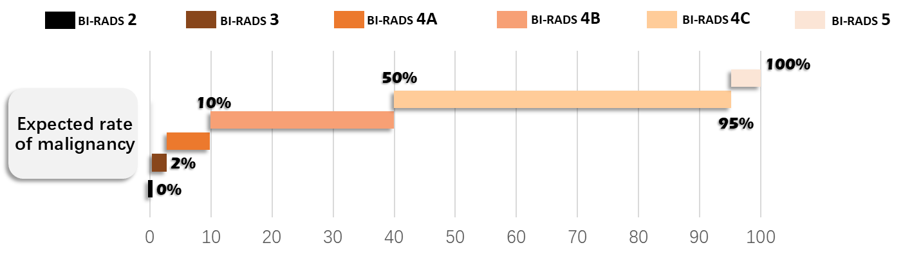
Background
Breast cancer has become the most common cancer in women
Ultrasound has been widely used for breast diagnosis
Benign and malignant
Breast Imaging Reporting and Data System (BI-RADS) categorization
BI-RADS 2, 3, 4a, 4b, 4c, 5
Fig. 1. Expected malignant rate of BI-RADS categories.
Medelson EB., Böhm-Vélez M., Berg W.A., et al.: ACR BI-RADS® Ultrasound. In ACR BI-RADS® Atlas, Breast Imaging Reporting and Data System. Reston, VA, American Col-lege of Radiology. (2013)

Slide 4
Related Works
Benign and malignant classification
BI-RADS 2/3, 4/5
BI-RADS 2/3, 4, 5
BI-RADS 2, 3, 4, 5
BI-RADS 2, 3, 4a, 4b, 4c, 5
Pathology binary classification and BI-RADS stratification
Shen Y., Shamout FE., Oliver JR., et al.: Artificial intelligence system reduces false-positive findings in the interpretation of breast ultrasound exams. Nat Commun, 12(1), 5645 (2021)
Byra M., Galperin M., Ojeda-Fournier H., Olson L., O'Boyle M., Comstock C., Andre M.: Breast mass classification in sonography with transfer learning using a deep convolutional neural network and color conversion. Med Phys, 46(2), 746-755 (2019)
Qian X., Zhang B., Liu S., Wang Y., Chen X., Liu J., Yang Y., Chen X., Wei Y., Xiao Q., Ma J., Shung KK., Zhou Q., Liu L., Chen Z.: A combined ultrasonic B-mode and color Doppler system for the classification of breast masses using neural network. Eur Radiol, 30(5), 3023-3033 (2020)
Liu J., et al.: Integrate Domain Knowledge in Training CNN for Ultrasonography Breast Cancer Diagnosis. Medical Image Computing and Computer Assisted Intervention – MICCAI 2018, vol 11071 (2018)
Xing J., Chen C., Lu Q., Cai X., Yu A., Xu Y., Xia X., Sun Y., Xiao J., Huang L.: Using BI-RADS Stratifications as Auxiliary Information for Breast Masses Classification in Ultra-sound Images. IEEE J Biomed Health Inform. 25(6), 2058-2070 (2021)

Slide 5
Challenges
Optimize the use of relevance between the pathology and BI-RADS categories
Minimize the gaps between predicted BI-RADS categories and annotations

Slide 6
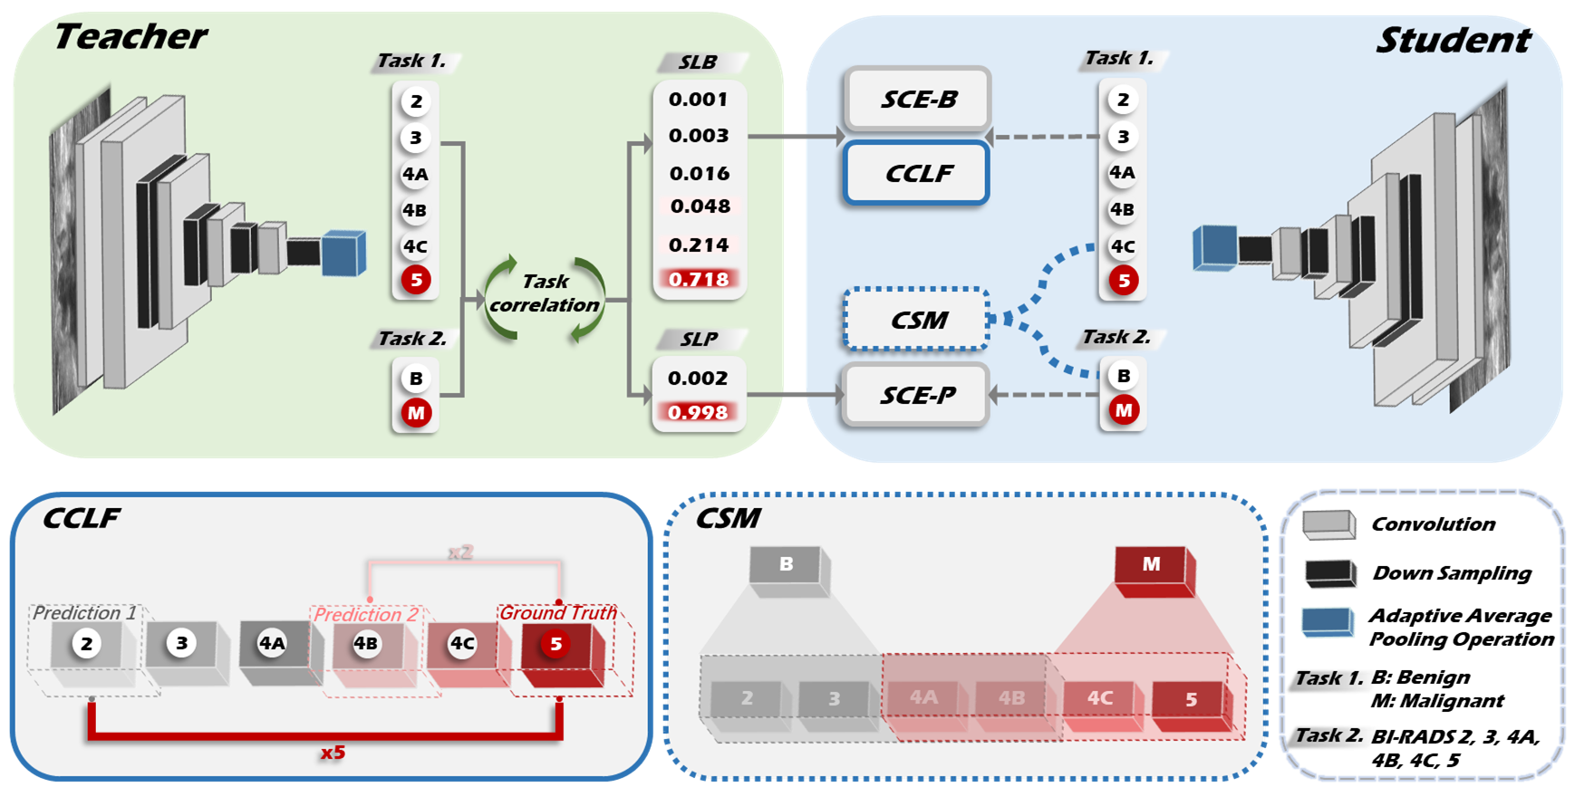
Methods
Fig. 2. Overall framework.

Slide 7
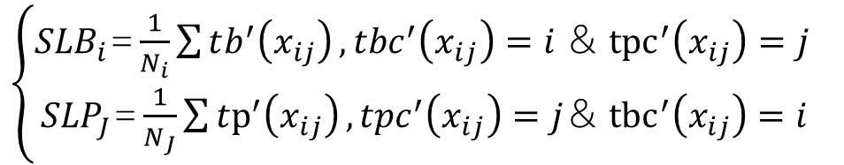
Methods – The multitask soft label generating architecture
Obtain task-related soft label
$\left\{\begin{aligned}{SLB}_{i}\text{=}\frac{1}{N_{i}}\sum{tb^{′}\left(x_{ij}\right)}, tbc^{′}\left(x_{ij}\right)=i &＆ {tpc}^{′}\left(x_{ij}\right)=j \\ {SLP}_{J}\text{=}\frac{1}{N_{J}}\sum{tp^{′}\left(x_{ij}\right)}, tpc^{′}\left(x_{ij}\right)=j&＆ {tbc}^{′}\left(x_{ij}\right)=i\end{aligned}\right.$

Slide 8
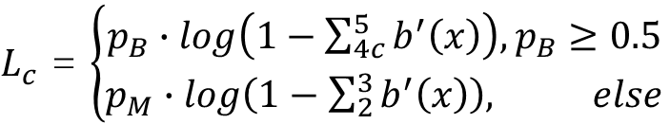
Methods – The consistency supervision mechanism (CSM)
Ensure the prediction consistency between two tasks
$L_{c}$ = $\left\{\begin{aligned}p_{B}∙log\left(1−\sum_{4c}^{5}{b^{′}\left(x\right)}\right),p_{B}≥0.5 \\ p_{M}∙log\left(1−\sum_{2}^{3}{b^{′}\left(x\right)}\right), else\end{aligned}\right.$

Slide 9
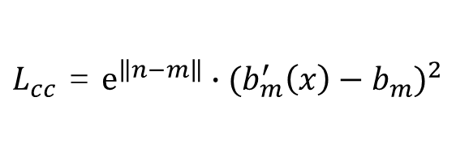
Methods – The cross-class loss function (CCLF)
Minimize gaps between predicted BI-RADS categories and annotations
$L_{cc}$ = $e^{\left\|\left.n−m\right\|\right.}∙{(b_{m}^{′}\left(x\right)−b_{m})}^{2}$

Slide 10
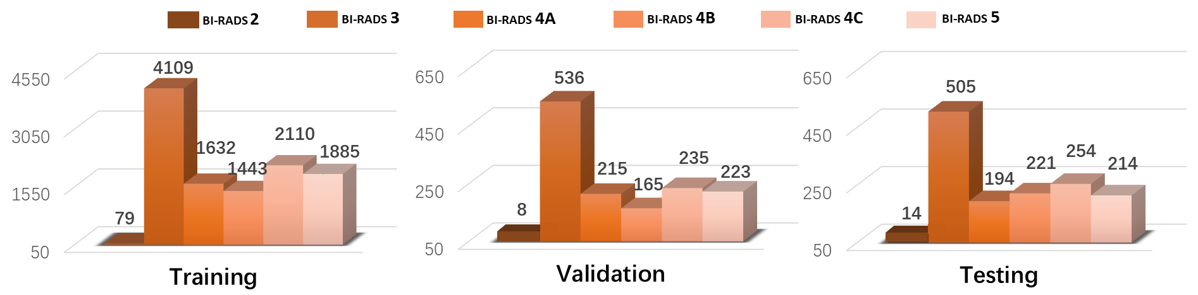
Experiments - Dataset
Table 1. Benign and malignant distribution at patient-level.
Fig. 3. BI-RADS distribution at image-level.

Slide 11
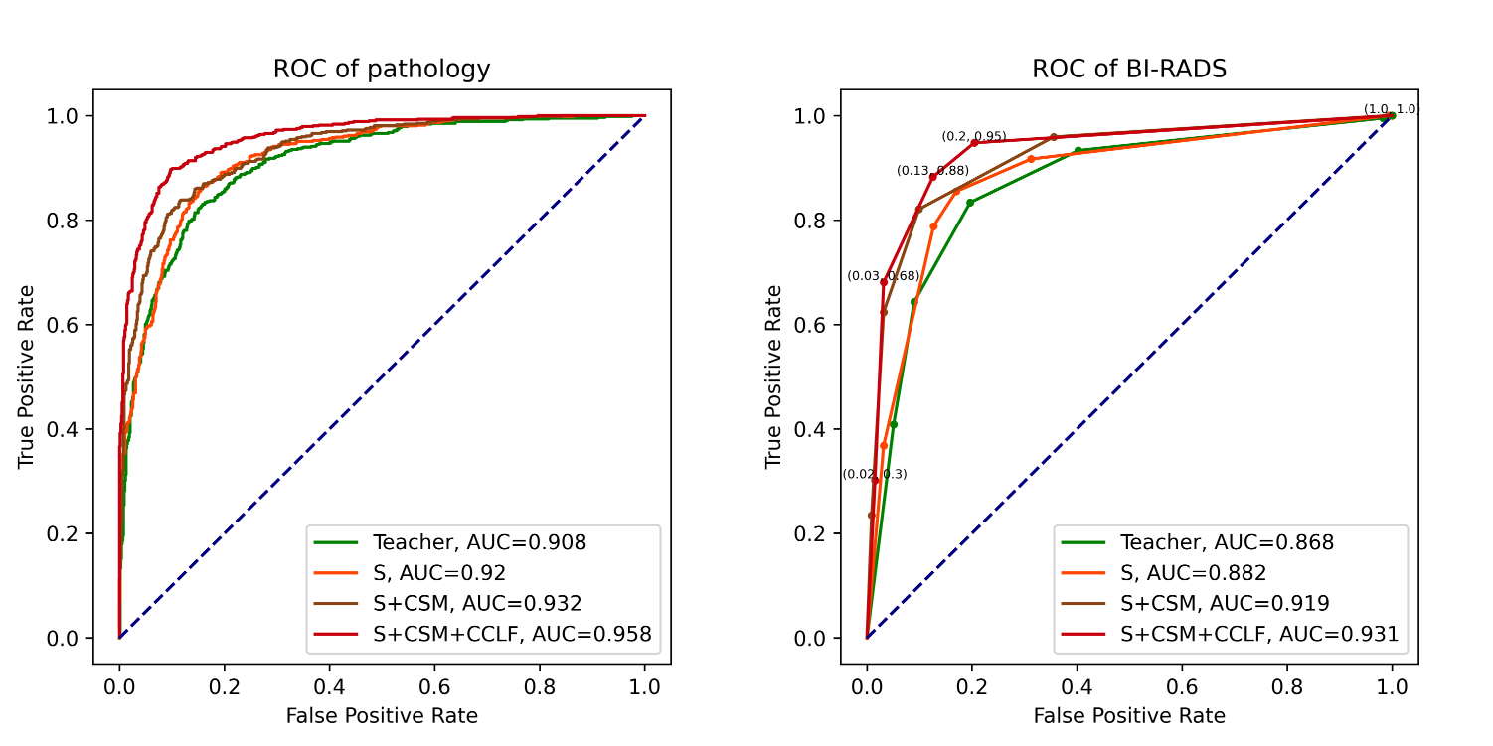
Results – Ablation study
Fig. 4. ROC comparison among ablation studies.

Slide 12
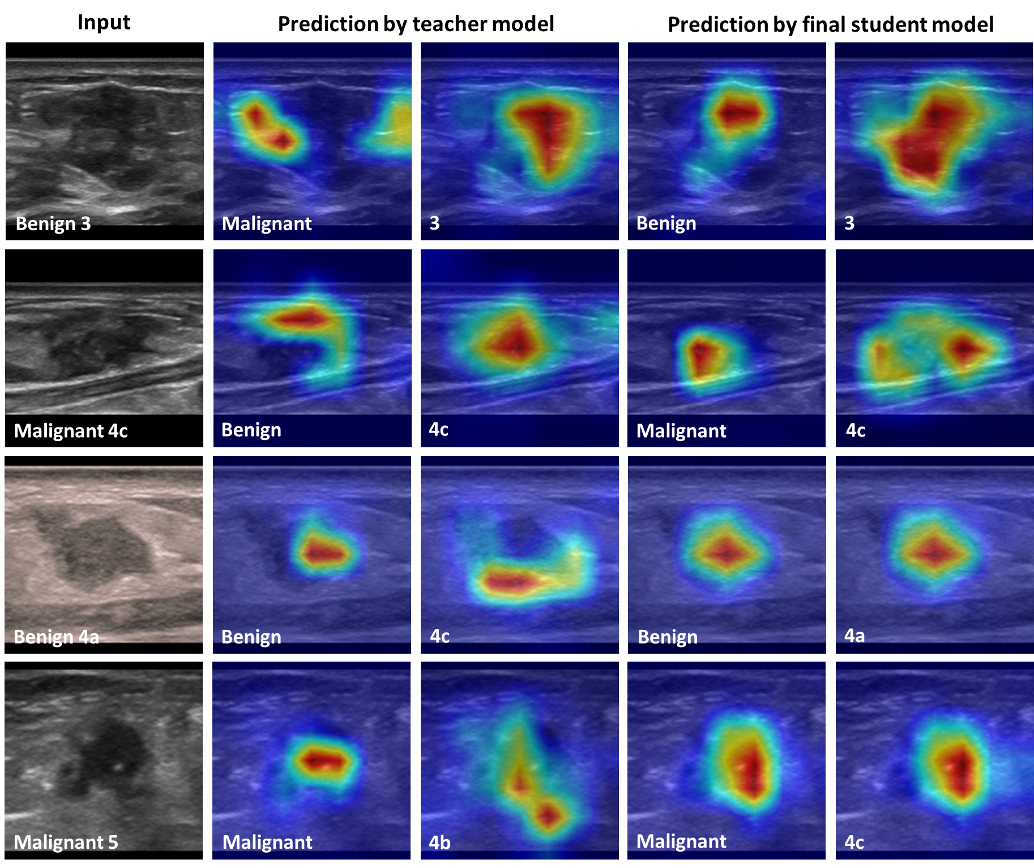
Results – Result comparison
Fig. 5. comparison of class activation maps.

Slide 13
Results – Result comparison
Table 2. Performance comparison on BUSI and UDIAT.

Slide 14
Conclusion
Our method successfully handled two challenges in breast ultrasound lesion risk stratification.
Improved the overall classification accuracy, and the consistency between two tasks.
Minimized the gaps between predicted BI-RADS categories and annotations.

Slide 15
THANKS

